Slide 1
Increase ROI on marketing efforts for a retail bank (Capstone 1)
Sanjiv Shrestha

Slide 2
Context
Marketing managers at retail banks
Strong interest in promoting different financial products to the bank’s clients
Specifically
Term deposit marketing is prioritized by marketing managers since banks get access to deposits for a defined term that then can be loaned out at good profit margins.

Slide 3
Specific Problem/Opportunity
Given a large universe of banking clients that have current accounts, who amongst them do marketing managers reach out to for promoting term deposits ?
Ideally, if they were given a specific list of banking clients that were most likely to subscribe to term deposit, they would waste little time reaching out to clients that have low likelihood of subscribing and focus primarily on clients with high likelihood of subscribing
This project aims to solve this problem for marketing managers and hence increase ROI on their marketing efforts

Slide 4
Methodology used for project
Data collection
Data cleaning
Data exploration
Data processing
Model training and prediction
Model comparison under different metrics

Slide 5
Data Collection
Data obtained from Kaggle
18 variables
8 numerical variables
10 categorical variables
Dependent variable is categorical
Indicates whether bank client subscribed to term deposit in this campaign or not
Classes were “yes”/1 and “no”/0
About 31,600 rows

Slide 6
Data Cleaning
Data relatively clean
No data cleaning needed

Slide 7
Data exploration
Most numerical variables had skewed distributions. Left them as they were.
No correlation amongst numerical variables. There was no need to drop any of them
Categorical variables were well defined
Dependent variable was imbalanced
Fewer positive classes i.e. “yes”/1 than negative classes i.e. “no”/0
Independent variables impacting dependent variable the most with statistical significance
‘Poutcome’ (indicates whether bank client subscribed to term deposit in previous campaign or not)
‘Contact’ (contact method used by marketing managers to reach out to bank clients)

Slide 8
Data processing
Left numerical variables as they were
Did one hot encoding for categorical variables with more than 2 labels
Created replace map (i.e. map to 0’s and 1’s) for categorical variables with exactly 2 labels
Split dataset into training set and test set

Slide 9
Model training and prediction
Models considered:
Logistic regression
Random Forest
Gradient Boost
SVM (support vector machine) - dropped due to performance issues on laptop
For each model:
Trained the model on training set
Used trained model to predict on test set
Evaluated model prediction quality under each evaluation metric

Slide 10
Model comparison under different metrics
Model evaluation metrics:
Accuracy
Confusion matrix
Classification report (F-1 score)
AUC PR (Area under curve for Precision Recall curve)

Slide 11
Model comparison under Accuracy (Higher the better)
Similar numbers for accuracy is misleading here. Typically, accuracy not a good metric for imbalanced dependent variable
Model | Accuracy (Number of correct predictions/Total number of predictions)
Logistic Regression | 0.897
Random Forest | 0.897
Gradient Boost | 0.909
Similar scores

Slide 12
Model comparison under Confusion matrix (Less FP’s and FN’s, the better)
Random Forest and Gradient Boost detect more actual 1’s than Logistic regression so they have less False negatives and hence are better binary classifiers. As a result of this, F-1 scores when class of dependent variable is 1 and AUC PR metrics are higher for them as well (as is evident in following slides)
Model (N=6330) | TN (True negative) | TP (True positive) | FP (False positive) | FN (False negative)
Logistic Regression | 5467 | 212 | 132 | 519
Random Forest | 5415 | 337 | 184 | 394
Gradient Boost | 5381 | 378 | 218 | 353
Less number of FN’s compared to Logistic regression

Slide 13
Model comparison under F-1 score (Higher the better)
Some definitions:
Precision = Positive predictive value = TP / (TP + FP)
Recall = True positive rate = TP / (TP + FN)
F-1 score = 2 / (1/Precision + 1/Recall)

Slide 14
Model comparison under F-1 score
Precision, Recall and F-1 scores similar to Logistic regression when class= 0
Model | Class of dependent variable | Precision | Recall | F-1 score
Logistic Regression | 0 | 0.91 | 0.98 | 0.94
Random Forest | 0 | 0.93 | 0.97 | 0.95
Gradient Boost | 0 | 0.94 | 0.96 | 0.95
Logistic Regression | 1 | 0.62 | 0.29 | 0.39
Random Forest | 1 | 0.65 | 0.46 | 0.54
Gradient Boost | 1 | 0.63 | 0.52 | 0.57
Precision scores similar to Logistic regression when class = 1
Recall scores higher compared to Logistic regression when class = 1 (since more actual 1’s are detected)
F-1 scores higher compared to Logistic regression when class = 1 (because of higher Recall scores)

Slide 15
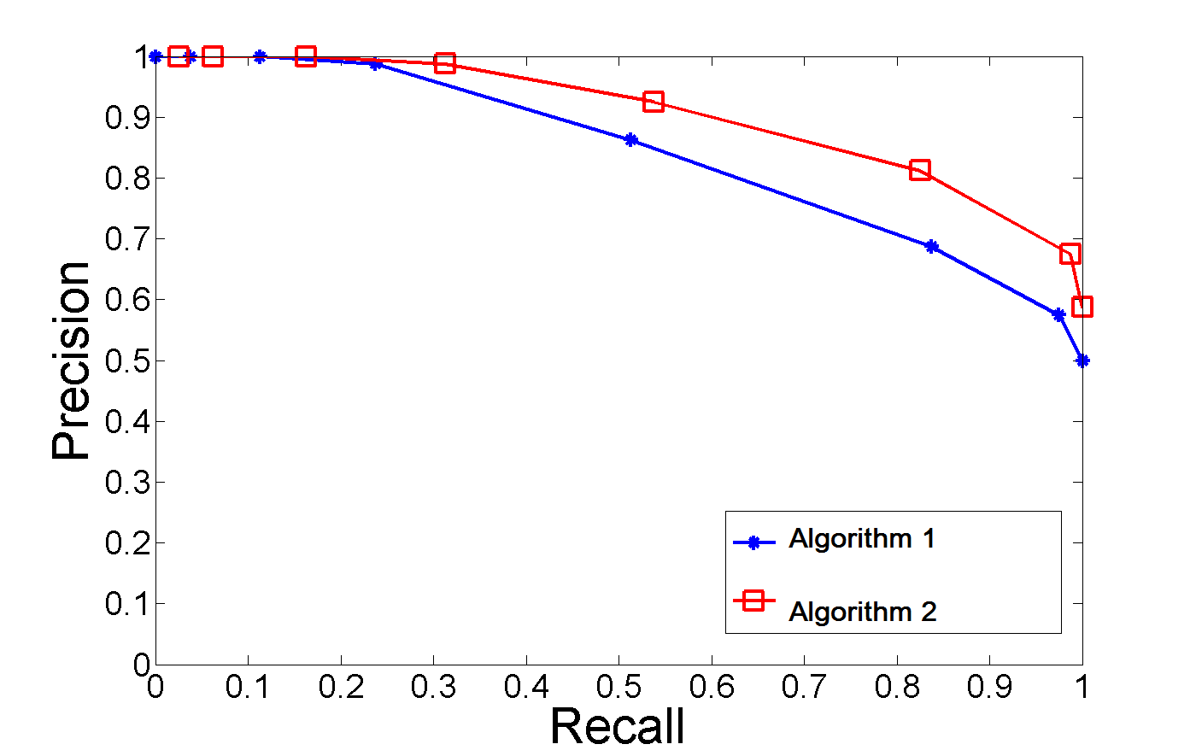
Model comparison under AUC PR (Higher the better)
Different model/algorithms result in different PR curves. PR curves are drawn at different thresholds for what qualifies as a 1 and a 0.

Slide 16
Model comparison under AUC PR
Random Forest and Gradient Boost have higher AUC(area under curve) for Precision Recall curve compared to Logistic regression since Recall scores are higher (since more actual 1’s are detected) which pushes the Precision Recall curve outward resulting in higher AUC PR. indicating they are better binary classifiers
Model | AUC for Precision Recall curve
Logistic Regression | 0.503
Random Forest | 0.646
Gradient Boost | 0.645
AUC PR scores higher compared to Logistic regression

Slide 17
Recommendation
For best results :
Use list of banking clients generated using either Random Forest or Gradient Boost model since they are better binary classifiers

Slide 18
Further work
Use SMOTE technique to resample dataset (so that the dependent variable is more balanced) before training the models. AUC PR metric (which is not sensitive to imbalanced classes) was used as a metric vs AUC ROC to account for this effect in this project.
Use Google colab to train with SVM (support vector machine) to get around performance issues on laptop

